Slide 1
QAG
Question and Answer Generation System from Course Materials

Slide 2
Group Details
IT14058424 – A.S.M Nibras
IT14033506 – M.F.F Mohamed
IT14121852 – I.S.M Arham
IT13001162 – A.M.M Mafaris
Project Id: 17-006
Supervisor: Ms. Anjalie Gamage

Slide 3
Introduction
In every school, they are conducting examinations periodically. This can be term based exams or chapter wise exams.
Conducting exams is the only way to identify and improve the knowledge of a student.
There isn’t any alternative to identify and improve the knowledge of a student other than conducting exams.
Important task of conducting exams are preparing question papers and answer schemes.

Slide 4
Identified Problems
Preparing exam papers manually takes time.
There are no system existing for Sri Lankan school systems.
Most questions do not cover full course objectives.
Existing systems do not provide answer schemes (Answers + Marks allocation)

Slide 5
Literature Review - Summery
Features | Revup | ArikIturri | wikitrivia | QAG
Generating Questions | ✓ | ✓ | ✓ | ✓
Generating Answers | ✓ | ✓ | ✓ | ✓
Allocating Marks | ✓ | ✗ | ✗ | ✓
Customizing Question Paper | ✗ | ✗ | ✗ | ✓
Printout the question paper and answer schema. | ✗ | ✗ | ✗ | ✓

Slide 6
Objective
Categorizing the text book content according to the topic and store in the database.
Filtering and identifying the content where the questions can be generated to test the knowledge.
Identifying key phrases and words that should be used to generate appropriate questions.
Forming proper questions using the identified key phrases from the context.
Allocate marks for each question.

Slide 7






System Diagram
Upload
PDF / WORD
Store
Lecture Content
PDF / WORD
Question Paper
Question Generation
Question
Bank

Slide 8
System Architecture

Slide 9
Methodology
Categorizing the text book content according to the topic and store in the database.
Categorize the lecture contents according to the chapter and its related contents from the pdf/ word document.
Identify the suitable domain of the ontology from the extracted information.
Identify the type of the ontologies (Static / Dynamic).
Storing the categorized information into the ontology driven database.

Slide 10
Methodology (Cont..)
2. Filtering and identifying the content where the questions can be generated to test the knowledge.
Retrieve the lecture content from the database and filter out the proper content where questions can be generated.
Take the complex sentences from the paragraph and generate possible elementary sentences out of it.
Store the elementary sentences into the database.

Slide 11
Methodology (Cont..)
3.Identifying key phrases and words that should be used to generate appropriate questions.
Get the sentences from database and classify each elementary sentence into two main classes named as Fine Classifier and Coarse Classifier.
In Fine classifier analyze the sentences and identify each words as noun, verb, adjective, proposition etc.
And fine classes are reduced to coarse classes determined by the class hierarchy such as “Human”, “Entity”, “Location”, “Time”, “Count” etc.
Store the words and key phrases into the database.

Slide 12
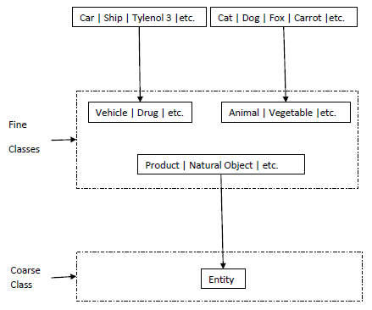
3.Identifying key phrases and words that should be used to generate appropriate questions (Cont..)

Slide 13
Methodology (Cont..)
4.Forming proper questions using the identified key phrases from the context.
Fetch elements of a sentence with its classification coarse classes, the verbs with their tense information.
Produce the type of questions that can be generated while considering coarse classes and verb tense.
Generate more than one possible question for a elementary sentence.
Clean up meaningless generated question/s
Store generated questions on ontology driven data base.

Slide 14
Benefits.
Easily Generate questions papers.
Prepare answer scheme along with the question paper.
Customize the question generation (Allocate weightage for chapters)
Simple user interface where anyone can use the system easily.
Generate various types of question for a particular paragraph.

Slide 15
Target Audience
The proposed system is going to be target Sri Lankan schools and institutions.
The subjects which the system work will be Health & Physical Education, History, Geography…etc

Slide 16
Business Plan
We have planned to deliver this system to Sri Lankan government schools for free of charge.
We will charge annual subscription amount for non government schools and institutions according to agreement.

Slide 17
Thank You
Q&A

